Slide 1
Oracle Purchasing --> Receiving --> Receiving Transaction
Navigation:

Slide 2
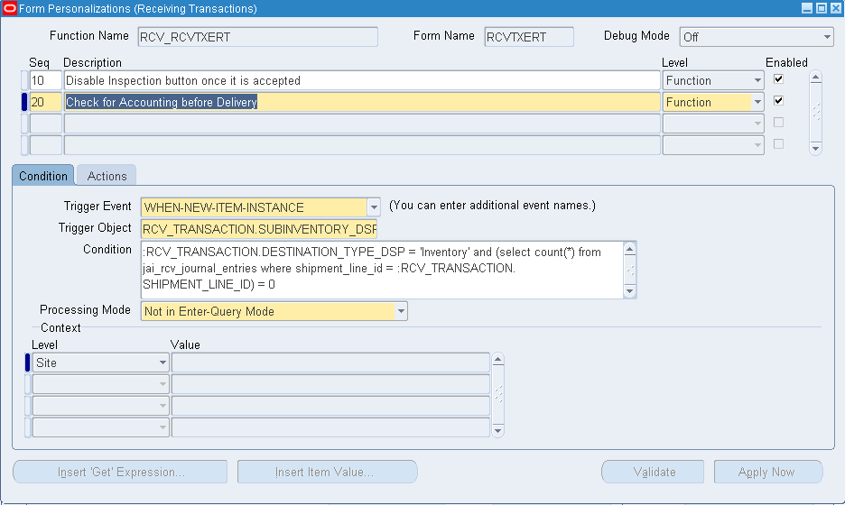

Slide 3
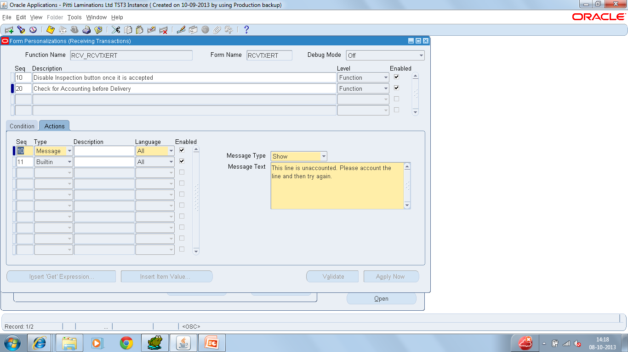

Slide 4
